Slide 1
Module 14 Network Simulation
Module 14-1
Module 14-2
Subnetting
VLSM
https://github.com/siagianp
https://www.youtube.com/@AmelOline/videos
https://github.com/amelcharolinesgn2/IoT_simulator-mqtt-NodeRed
https://github.com/amelcharolinesgn2/Cloud-Infrastructures
https://github.com/amelcharolinesgn2/ClouD-Infrastructure-SISKA-2025
https://github.com/amelcharolinesgn2/Gyroscope-Sensor-Data-Accelerometer
https://github.com/amelcharolinesgn2/Anjar_T
https://github.com/amelcharolinesgn2/Anjar_Lab
https://github.com/amelcharolinesgn2/ANJAR
https://drive.google.com/drive/folders/1YLs2wBBL3gWKKkh2g9nfVtOajQ7x6Mud

Slide 2
Overview
Background
Objective
Subnetting
Variable Length Subnet Mask
Classless Inter-Domain Routing

Slide 3
Background
Many people from Information & Technological background are still not yet understand about subnetting.
There is an opportunity for can be a new learning system in the future.
Students still find it difficult to ask questions to the lecturer when they are not in the class having lecturer.
Designing and developing a different web-based learning application as a media for helping users in learning certain material and in communicating with the application administrator.
Identify, learn, explore, and implement the method of Variable Length Subnet Mask (VLSM) and Classless Inter-Domain Routing (CIDR).

Slide 4
What is subnetting?
Technique.
One larger network.
Smaller network.
Same subnet mask.
Classful networking.
Reduced network traffic.
Optimized network performance.
Simplified management.
Facilitated spanning of large geographical distances.

Slide 5
How to do subnetting? (1)
Find the required subnet mask from biggest hosts number.
Example :
Network Address = 192.168.0.0
Host A = 10
Host B = 20
Host Portion = 2^{n} ← 20 , n = 5
Subnet Mask = 255.255.255.11100000
255.255.255.224, /27

Slide 6
How to do subnetting? (2)
Find host number per network.
Example :
Subnet Mask = 255.255.255.11100000
Host Number = 2^{n}-2, n = Numbers of 0 in binary
Host Number = 30

Slide 7
How to do subnetting? (3)
Calculataion the valid IP address per network.
Example :
Host A : Network Address = 192.168.0.0/27
IP Address = 192.168.0.1 – 192.168.0.30
Boardcast Address = 192.168.0.31
Host B : Network Address = 192.168.0.32/27
IP Address = 192.168.0.33 – 192.168.0.62
Boardcast Address = 192.168.0.63

Slide 8
What is VLSM?
VLSM = Subnetting.
Different technique.
Different subnet mask.
Classless networking.
Reduced empty IP Address spaces.
Have a backup IP Address for future.

Slide 9
How to do VLSM? (1)
Sorting the hosts number depend on the most hosts number usage.
Example :
Network Address : 192.168.0.0
Host A : 10 Host B : 20
Host B : 20 Host A : 10

Slide 10
How to do VLSM? (2)
Specifies a subnet mask depend on the needed hosts number.
Example :
B : 20 + 1 network + 1 boardcast = 22 /27
A : 10 + 1 network + 1 boardcast = 12 /28

Slide 11
How to do VLSM? (3)
Calculation the valid IP address per network.
Example :
Host B : Network Address = 192.168.0.0/27
IP Address = 192.168.0.1 – 192.168.0.30
Boardcast Address = 192.168.0.31
Host A : Network Address = 192.168.0.32/28
IP Address = 192.168.0.33 – 192.168.0.46
Board Address = 192.168.0.47

Slide 12
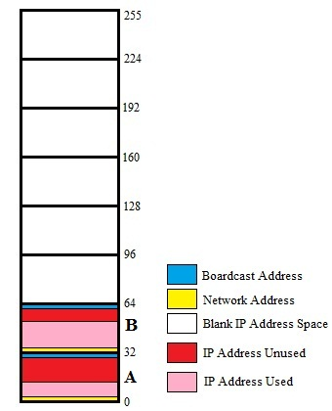
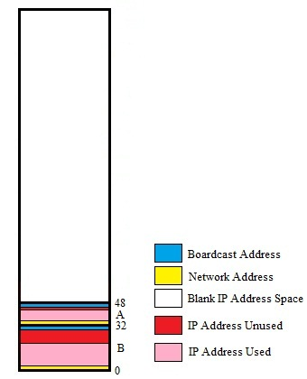
Subnetting Vs VLSM
Subnetting
VLSM
Vs

Slide 13
IP Addressing
32 bits
Dotted Decimal
Network
Host
255
255
255
255
Maximum
Notes:
Layer 1 of 3:
Purpose: This figure show the general format of an IP address.
In layer 1, the address is 32 bits with a network and host portion.

Slide 14
IP Addressing
32 bits
Dotted Decimal
Network
Host
255
255
255
255
Maximum
1
8
9
16
17
24
25
32
11111111
11111111
11111111
11111111
Binary
128 64 32 16 8 4 2 1
128 64 32 16 8 4 2 1
128 64 32 16 8 4 2 1
128 64 32 16 8 4 2 1
Notes:
Layer 3 of 3:
In layer 2, one can convert the address to binary.

Slide 15
IP Addressing
32 bits
Dotted Decimal
Network
Host
255
255
255
255
Maximum
1
8
9
16
17
24
25
32
11111111
11111111
11111111
11111111
Binary
128 64 32 16 8 4 2 1
128 64 32 16 8 4 2 1
128 64 32 16 8 4 2 1
128 64 32 16 8 4 2 1
Example Decimal
172
16
122
204
10101100
00010000
01111010
11001100
Example Binary
Notes:
Layer 3 of 3:
In layer 3, an example of dotted-decimal format and binary are displayed.
Emphasize: IP address format is dotted-decimal. Dotted-decimal makes it easy to work with IP addresses. However, in this course we will work with the addresses on the bit level, so we will convert these addresses into binary, make changes to them, and convert them back.
The central authority for addresses is the Internet Assigned Numbers Authority.
Note: This most common form of addressing reflects the widely used IP version 4. Faced with the problem of depleting available addresses, Internet Engineering Task Force (IETF) work is under way for a backward-compatible next generation of IP (IPng, also called IP 6).
IP 6 will offer expanded routing and addressing capabilities with 128-bit addresses rather than the 32-bit addressing shown on the graphic. Addresses from both IP versions will coexist. Initial occurrences will probably be at locations with address translator software and firewalls.

Slide 16
IP Address Classes
8 bits
8 bits
8 bits
8 bits
Class A:
Class B:
Class C:
Class D: Multicast
Class E: Research
Network
Host
Host
Host
Network
Network
Host
Host
Network
Network
Network
Host
Notes:
Purpose: This graphic describes the three most common classes of IP address.
Emphasize: Discuss classes of addresses. Each address contains information about the network number and the host number of the device. Class A addresses are for very large organizations. Class B addresses are for smaller organizations, and Class C addresses for even smaller ones.
As the number of networks grows, classes may eventually be replaced by another addressing mechanism, such as classless interdomain routing (CIDR). RFC 1467, Status of CIDR Deployment in the Internet, presents information about CIDR. RFC 1817, CIDR and Classful Routing, also presents CIDR information.

Slide 17
IP Address Classes
1
8
9
16
17
24
25
32
Bits:
0NNNNNNN
Host
Host
Host
Class A:
Range (1-126)
1
8
9
16
17
24
25
32
Bits:
10NNNNNN
Network
Host
Host
Class B:
Range (128-191)
1
8
9
16
17
24
25
32
Bits:
110NNNNN
Network
Network
Host
Class C:
Range (192-223)
1
8
9
16
17
24
25
32
Bits:
1110MMMM
Multicast Group
Multicast Group
Multicast Group
Class D:
Range (224-239)
Notes:
Emphasize: Highlight the fixed values that start each class address.
The first octet rule states that when an address falls into a specified range, it belongs to a certain class. Students should soon be able to recognize the address class of any IP address on sight.
Note: If time or interest permits, you can use the initial bit patterns in the first octet and show how a class of IP network derives the range of network numbers for that IP address class.

Slide 18
Host Addresses
172.16.2.1
10.1.1.1
10.6.24.2
E1
172.16.3.10
E0
10.250.8.11
172.16.2.1
172.16.12.12
10.180.30.118
Routing Table
172.16
Network
Interface
.
12
.
12
Network
Host
172.16.0.0
10.0.0.0
E0
E1
Notes:
Purpose: This figure presents an overview of host and network address conventions.
Emphasize: In the example, 172.16.0.0 and 10.0.0.0 refer to the wires at each end of the router.
Explain how the routing table is used. Entries in the routing table refer to the network only. The router does not know the location of hosts—it knows the location of networks.
.

Slide 19
Determining Available Host Addresses
Network
Host
172 16 0 0
N
10101100
00010000
00000000
00000000
1
16 15 14 13 12 11 10 9
8 7 6 5 4 3 2 1
00000000
00000001
2
00000000
00000011
3
...
...
...
11111111
11111101
65534
11111111
11111110
65535
11111111
11111111
65536
-
2
2^{N}-2 = 2¹⁶-2 = 65534
65534
Notes:
Purpose: This figure explains how to calculate the number of available hosts in a network.
Emphasize: 2^{N}-2 is the calculation to determine available hosts. N is the number of binary digits in the host field. Subtract 2 because a host cannot be all 0s or 1s.
The same principal applies when determining the number of available networks.

Slide 20
IP Address Classes Exercise
Address
Class
Network
Host
10.2.1.1
128.63.2.100
201.222.5.64
192.6.141.2
130.113.64.16
256.241.201.10
Notes:
Layer 1 of 2:
Purpose: This exercise verifies that the students understand IP address classes, network numbers, and host numbers.
Give the students time to list the address class, network, and host number for each IP address in the table. Review the correct answers interactively.
The answers are given in the following figure.

Slide 21
IP Address Classes Exercise Answers
Address
Class
Network
Host
10.2.1.1
A
10.0.0.0
0.2.1.1
128.63.2.100
B
128.63.0.0
0.0.2.100
201.222.5.64
C
201.222.5.0
0.0.0.64
192.6.141.2
C
192.6.141.0
0.0.0.2
130.113.64.16
B
130.113.0.0
0.0.64.16
256.241.201.10
Nonexistent
Notes:
Layer 2 of 2:
Purpose: This answers to the exercise are given in the figure.
Note: Students can also find the answers to this exercise in the “Answers” appendix.

Slide 22
Addressing without Subnets
172.16.0.1
172.16.0.2
172.16.0.3
172.16.255.253
172.16.255.254
…...
172.16.0.0
Network 172.16.0.0
Notes:
Purpose: This figure explains what networks look like without subnets.
Without subnets, use of network addressing space is inefficient.
The Class B network is like a highway with no exits—there is no place to exit, so all of the traffic is in one line.

Slide 23
Addressing with Subnets
172.16.3.0
172.16.4.0
172.16.1.0
172.16.2.0
Network 172.16.0.0
Notes:
Purpose: This figure describes network structure when subnets are used.
Emphasize: The host bits of an IP address can be subdivided into a subnetwork section and a host section. The subnetwork section in this example is the full third octet.
Point out the difference in the addressing between the previous slide and this slide.
A subnetted address space is like a highway with exits.
A network device uses a subnet mask to determine what part of the IP address is used for the network, the subnet, and the device ID.
A subnet mask is a 32-bit value containing a number of one bits for the network and subnet ID and a number of zero bits for the host ID.
Given its own IP address and subnet mask, a device can determine if an IP packet is destined for 1) a device on its own subnet, 2) a device on a different subnet on its own network, or 3) a device on a different network.
A device can determine what class of address the device has been assigned from its own IP address. The subnet mask then tells the device where the boundary is between the subnet ID and the host ID.

Slide 24
Subnet Addressing
172.16.2.200
172.16.3.5
172.16.3.1
E1
172.16.2.2
E0
172.16.3.100
172.16.2.1
172.16.2.160
172.16.3.150
New Routing Table
172.16
Network
Interface
.
2
.
160
Network
Host
172.16.0.0
172.16.0.0
E0
E1
Notes:
Layer 1 of 2:
Purpose: This figure shows what would happen if there were no subnetting.
Emphasize: If networks could not be broken down into more granular, subnetworks few networks could exist, each with a capacity for many hosts.

Slide 25
Subnet Addressing
172.16.2.200
172.16.3.5
172.16.3.1
E1
172.16.2.2
E0
172.16.3.100
172.16.2.1
172.16.2.160
172.16.3.150
New Routing Table
172.16
160
Network
Interface
.
2
.
Network
Subnet
Host
172.16.2.0
172.16.3.0
E0
E1
Notes:
Layer 1 of 2:
Emphasize: By turning on more bits in the mask, we reserve some bits as network information and can use these bits to describe subnetworks.
Describe how the router makes use of this technique. Point out that there is more information in the routing table now.
Note: As you enter the discussion about subnet masks, a question might arise about whether it is legal to define a discontiguous subnet mask. A discontiguous subnet mask consists of intervening zeros, as in 101111011000, rather than all ones followed by zeros, as in 1111111100000000. The question has two answers. According to RFC 950 that describes IP, a discontiguous subnet mask is legal. However, the hardware expense to produce an interface that supports discontiguous masking is cost-prohibitive. Thus in practice it is not supported on most vendors’ equipment, including Cisco. Also, discontiguous masking has no benefit, and it is much more difficult to maintain a network based on this design. Later RFCs make noncontiguous subnet masks illegal because they are incompatible with future addressing schemes such as CIDR.

Slide 26
Subnet Mask
Network
Host
IP Address
172
16
0
0
Network
Host
Default Subnet Mask
255
255
0
0
11111111
11111111
00000000
00000000
Also written as “/16” where 16 represents the number of 1s in the mask.
Network
Subnet
Host
8-bit Subnet Mask
255
255
255
0
Also written as “/24” where 24 represents the number of 1s in the mask.
Notes:
Emphasize: Turn on more bits to represent subnets.
Compare the default or standard subnet mask with the subnet mask in the slide.
These are the rules for IP addressing:
An address is 32 bits, divided into three components:
First octet rule bits
Network bits (path selection bits)
Node bits
The first octet rule states that the most significant bit pattern in the first octet determines the class of the address.
Path selection bits cannot be all ones or zeros.
Certain addresses are reserved. RFC 1918 defines some of those.
Prefix or mask one bits are path selection significant; zero bits are host bits and therefore not significant.
Use the logical AND to combine the address and mask bits to get the subnet address.
The maximum number of available subnets equals 2 ^{prefix bits} - 2; the maximum number of available hosts equals 2 ^{32- prefix bits} - 2.

Slide 27
Decimal Equivalents of Bit Patterns
128 64 32 16 8 4 2 1
1 0 0 0 0 0 0 0 = 128
1 1 0 0 0 0 0 0 = 192
1 1 1 0 0 0 0 0 = 224
1 1 1 1 0 0 0 0 = 240
1 1 1 1 1 0 0 0 = 248
1 1 1 1 1 1 0 0 = 252
1 1 1 1 1 1 1 0 = 254
1 1 1 1 1 1 1 1 = 255
Notes:
Purpose: This figure explains how subnet masks are converted to decimal addresses.
Emphasize: Review binary-to-decimal conversion, bit weighting, and conversion.
Explain logical AND.
One possible explanation of logical AND follows: We will need to be able to perform a logical AND on the binary numbers. Just take two binary numbers and place one above the other. The ones in the bottom are like a pipe—the number above it just drops through. The zeros are like a clogged pipe, so nothing comes out in the answer.
Presenting a truth table will help some students understand. You might need to give more than one explanation.
Note: You might want to hand out a binary-to-decimal conversion sheet if you have not already done so. We have not included one in the lab section. It is more useful to have one that is on a separate page from the labs.

Slide 28
Subnet Mask without Subnets
Network
Host
172.16.2.160
10101100
00010000
00000010
10100000
255.255.0.0
11111111
11111111
00000000
00000000
10101100
00010000
00000000
00000000
Network Number
172
16
0
0
Subnets not in use—the default
Notes:
Purpose: This graphic explains how routers use addresses that have no subnet mask.
Emphasize: Explain how masking works at the bit level. Zero bits mask host information.
Note: This is an easy place to lose students. At this point, they need to learn several abstract mathematical concepts before we can show them how to lay out an IP-addressed network. To the novice these techniques may seem unrelated, making the presentation confusing. To a more experienced audience, these techniques will be familiar.

Slide 29
Subnet Mask with Subnets
Network
Subnet
Host
172.16.2.160
10101100
00010000
00000010
10100000
255.255.255.0
11111111
11111111
11111111
00000000
10101100
00010000
00000010
00000000
128
192
224
240
248
252
254
255
Network Number
172
16
2
0
Network number extended by eight bits
Notes:
Purpose: This figure shows how the router determines an address when subnetting is used.
Emphasize: This example makes a Class B address space look like a collection of Class C address spaces.
Now the logical AND allows us to extract the subnet number as well as the assigned network number.
An exercise follows that tests the students’ understanding of subnet masks.

Slide 30
Subnet Mask with Subnets (cont.)
Network
Subnet
Host
172.16.2.160
10101100
00010000
00000010
10100000
255.255.255.192
11111111
11111111
11111111
11000000
10101100
00010000
00000010
10000000
128
192
224
240
248
252
254
255
128
192
224
240
248
252
254
255
Network Number
172
16
2
128
Network number extended by ten bits
Notes:
Purpose: This figure shows how the router determines an address when subnetting is used.
Emphasize: This example is different from the previous example in that the the subnet and host are divided within an octet.
Transition: An exercise follows that tests the students’ understanding of subnet masks.

Slide 31
Subnet Mask Exercise
Address
Subnet Mask
Class
Subnet
172.16.2.10
255.255.255.0
10.6.24.20
255.255.240.0
10.30.36.12
255.255.255.0
Notes:
Layer 1 of 2:
Purpose: This exercise is for the students to take the given IP addresses and associated subnet masks and perform a logical AND to extract the subnet number. Provide time in class and review the answers after the majority of students have finished.
The answers are given in the following figure.

Slide 32
Subnet Mask Exercise Answers
Address
Subnet Mask
Class
Subnet
172.16.2.10
255.255.255.0
B
172.16.2.0
10.6.24.20
255.255.240.0
A
10.6.16.0
10.30.36.12
255.255.255.0
A
10.30.36.0
Notes:
Layer 2 of 2:
Purpose: This answers to the exercise are given in the figure.
Note: Students can also find the answers to this exercise in the “Answers” appendix.

Slide 33
Broadcast Addresses
172.16.3.0
172.16.4.0
172.16.1.0
172.16.3.255
(Directed broadcast)
172.16.2.0
255.255.255.255
(Local network broadcast)
X
172.16.255.255
(All subnets broadcast)
Notes:
Purpose: This figure explains how broadcast addresses work.
Emphasize: A range of addresses is needed to allocate address space. A valid range of addresses is between subnet zero and the directed broadcast.
These RFCs provide more information about broadcasts:
RFC 919, Broadcasting Internet Datagrams
RFC 922, Broadcasting IP Datagrams in the Presence of Subnets
Cisco’s support for broadcasts generally complies with these two RFCs. It does not support multisubnet broadcasts that are defined in RFC 922.

Slide 34
Addressing Summary Example
172
16
2
160
172.16.2.160
10101100
00010000
00000010
10100000
Host
1
255.255.255.192
Mask
Subnet
4
Broadcast
First
Last
Notes:
Layer 1 of 9:
Purpose: This example summarizes The IP addressing that was covered earlier in this chapter.
Emphasize:
In layer 1, convert the address to a binary host address.

Slide 35
Addressing Summary Example
172
16
2
160
172.16.2.160
10101100
00010000
00000010
10100000
Host
1
255.255.255.192
Mask
11111111
11111111
11111111
11000000
2
Subnet
Broadcast
First
Last
Notes:
Layer 2 of 9:
Emphasize: In layer 2, write the subnet mask in binary.

Slide 36
Addressing Summary Example
172
16
2
160
3
172.16.2.160
10101100
00010000
00000010
10100000
Host
1
255.255.255.192
Mask
11111111
11111111
11111111
11000000
2
Subnet
Broadcast
First
Last
7
Notes:
Layer 3 of 9:
Emphasize: In layer 3, draw a line after the recursive ones in the subnet mask.

Slide 37
Addressing Summary Example
172
16
2
160
3
172.16.2.160
10101100
00010000
00000010
10100000
Host
1
255.255.255.192
Mask
11111111
11111111
11111111
11000000
2
Subnet
10000000
4
Broadcast
First
Last
Notes:
Layer 4 of 9:
Emphasize: In layer 4, fill in zeros beyond the vertical line for the subnet.

Slide 38
Addressing Summary Example
172
16
2
160
3
172.16.2.160
10101100
00010000
00000010
10100000
Host
1
255.255.255.192
Mask
11111111
11111111
11111111
11000000
2
Subnet
10000000
4
10111111
Broadcast
5
First
6
Last
Notes:
Layer 5 of 9:
Emphasize: In layer 5, fill in ones beyond the vertical line for the broadcast address.

Slide 39
Addressing Summary Example
172
16
2
160
3
172.16.2.160
10101100
00010000
00000010
10100000
Host
1
255.255.255.192
Mask
11111111
11111111
11111111
11000000
2
Subnet
10000000
4
10111111
Broadcast
5
10000001
First
6
Last
Notes:
Layer 6 of 9:
Emphasize: In layer 6, fill in 0s beyond the vertical line except for the last bit. Make that bit a 1. This is the first usable host address.

Slide 40
Addressing Summary Example
172
16
2
160
3
172.16.2.160
10101100
00010000
00000010
10100000
Host
1
255.255.255.192
Mask
11111111
11111111
11111111
11000000
2
Subnet
10000000
4
10111111
Broadcast
5
10000001
First
6
Last
10111110
7
Notes:
Layer 7 of 9:
Emphasize: In layer 7, fill in 1s beyond the vertical line except for the last bit. Make that bit a 0. This is the last usable host address.

Slide 41
Addressing Summary Example
172
16
2
160
3
172.16.2.160
10101100
00010000
00000010
10100000
Host
1
255.255.255.192
Mask
11111111
11111111
11111111
11000000
2
8
Subnet
10101100
00010000
00000010
10000000
4
10101100
00010000
00000010
10111111
Broadcast
5
10101100
00010000
00000010
10000001
First
6
10101100
00010000
00000010
Last
10111110
7
Notes:
Layer 8 of 9:
Emphasize: In layer 8, copy the binary network and subnetwork address from the top row into the lower rows.

Slide 42
Addressing Summary Example
172
16
2
160
3
172.16.2.160
10101100
00010000
00000010
10100000
Host
1
255.255.255.192
Mask
11111111
11111111
11111111
11000000
2
9
8
Subnet
172.16.2.128
10101100
00010000
00000010
10000000
4
172.16.2.191
10101100
00010000
00000010
10111111
Broadcast
5
172.16.2.129
10101100
00010000
00000010
10000001
First
6
172.16.2.190
10101100
00010000
00000010
Last
10111110
7
Notes:
Layer 9 of 9:
Emphasize: In layer 9, convert binary back to dotted decimal.

Slide 43
Class B Subnet Example
IP Host Address: 172.16.2.121
Subnet Mask: 255.255.255.0
Network
Network
Subnet
Host
172.16.2.121:
10101100
00010000
00000010
01111001
255.255.255.0:
11111111
11111111
11111111
00000000
Subnet:
10101100
00010000
00000010
00000000
Broadcast:
10101100
00010000
00000010
11111111
Subnet Address = 172.16.2.0
Host Addresses = 172.16.2.1–172.16.2.254
Broadcast Address = 172.16.2.255
Eight bits of subnetting
Notes:
Purpose: This figure shows an example of a Class B network with a subnet.

Slide 44
Subnet Planning
20 subnets
5 hosts per subnet
Class C address:
192.168.5.0
192.168.5.16
Other
subnets
192.168.5.32
192.168.5.48
Notes:
Purpose: This figure explains how to plan subnet numbers.
Emphasize: What if this were a Class B address? How many bits would we have for subnetting then? Where do you want to draw the line now?
Alternatives to review: Creating the subnet at the octet boundary is easier to work with—more host bits and more subnet bits.
Explain that the decision is really a guess on how you think your network will grow—will it have more subnets or more hosts?
RFC 1219 Mirroring: Mirroring hedges the subnetting decision by buying time. Do not use mirroring if you intend to use route summarization or variable-length subnet masking (VLSM); they are incompatible with mirroring.

Slide 45
Class C Subnet Planning Example
IP Host Address: 192.168.5.121
Subnet Mask: 255.255.255.248
Network
Network
Network
Subnet
Host
192.168.5.121:
11000000
10101000
00000101
01111001
255.255.255.248:
11111111
11111111
11111111
11111000
Subnet:
11000000
10101000
00000101
01111000
Broadcast:
11000000
10101000
00000101
01111111
Subnet Address = 192.168.5.120
Host Addresses = 192.168.5.121–192.168.5.126
Broadcast Address = 192.168.5.127
Five Bits of Subnetting
Notes:
Purpose: This figure shows an example of a Class C network with a subnet.
Emphasize: Contrast the Class C network subnet mask with the previous Class B example.

Slide 46
Broadcast Addresses Exercise
Address
Subnet Mask
Class
Subnet
Broadcast
201.222.10.60
255.255.255.248
15.16.193.6
255.255.248.0
128.16.32.13
255.255.255.252
153.50.6.27
255.255.255.128
Notes:
Layer 1 of 2:
Purpose: Have the students calculate the subnet numbers and the broadcast address for each subnet from the given IP addresses and subnet masks.

Slide 47
Broadcast Addresses Exercise Answers
Address
Subnet Mask
Class
Subnet
Broadcast
201.222.10.60
255.255.255.248
C
201.222.10.56
201.222.10.63
15.16.193.6
255.255.248.0
A
15.16.192.0
15.16.199.255
128.16.32.13
255.255.255.252
B
128.16.32.12
128.16.32.15
153.50.6.27
255.255.255.128
B
153.50.6.0
153.50.6.127
Notes:
Layer 2 of 2:
Purpose: This answers to the exercise are given in the figure.
Note: Students can also find the answers to this exercise in the “Answers” appendix.

Slide 48
Module 14-1 Subnetting

Slide 49
Objectives:
Chapter 14-2: IP Addressing
Internet Architecture IPv4 Addressing IP address Classes Subnets and subnet mask Subnets design with IP addressing IPv6

Slide 50
Internet Architecture
Two computers, anywhere in the world, following certain hardware, software, protocol specifications, can communicate, reliably even when not directly connected.
LANs are no longer scalable beyond a certain number of stations or geographic separation.

Slide 51
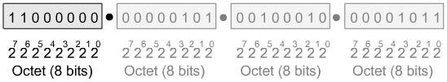
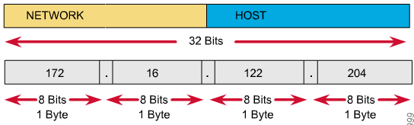
IP Address as a 32-Bit Binary Number
Internet Addresses

Slide 52
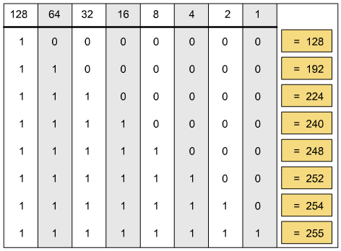
Decimal Equivalents of 8-Bit Patterns

Slide 53
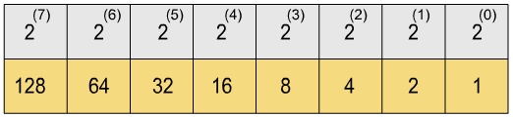
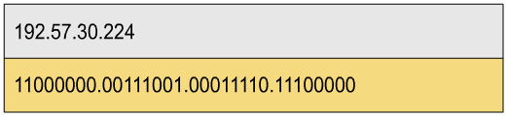
Binary and Decimal Conversion

Slide 54
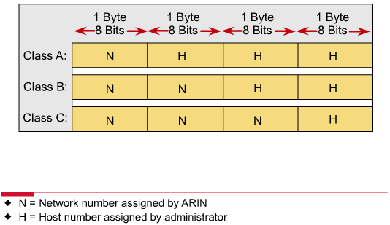
IP Address Classes

Slide 55
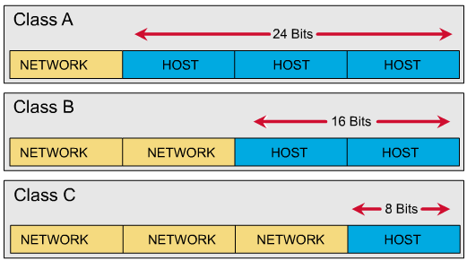
IP Address Classes

Slide 56
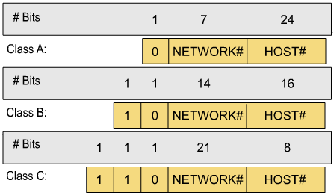
IP Addresses as Decimal Numbers

Slide 57
Hosts for Classes of IP Addresses
Class A (24 bits for hosts) 2²⁴ - 2* = 16,777,214 maximum hosts
Class B (16 bits for hosts) 2¹⁶ - 2* = 65,534 maximum hosts
Class C (8 bits for hosts) 2⁸ - 2* = 254 maximum hosts
* Subtracting the network and broadcast reserved address

Slide 58
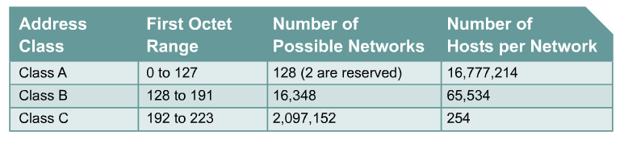
IPv4 Address Classes
Class D Addresses
A Class D address begins with binary 1110 in the first octet.
First octet range 224 to 239.
Class D address can be used to represent a group of hosts called a host group, or multicast group.
Class E Addresses
First octet of an IP address begins with 1111
First octet range 240 to 255.
Class E addresses are reserved for experimental purposes and should not be used for addressing hosts or multicast groups.

Slide 59
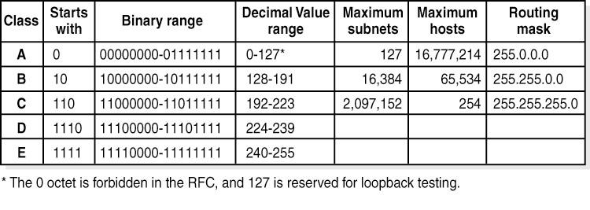
IP Addresses as Decimal Numbers

Slide 60
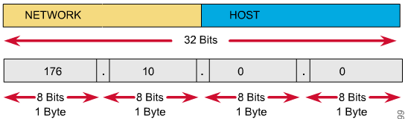
Network IDs and Broadcast Addresses
An IP address such as 176.10.0.0 that has all binary 0s in the host bit positions is reserved for the network address.
An IP address such as 176.10.255.255 that has all binary 1s in the host bit positions is reserved for the broadcast address.

Slide 61
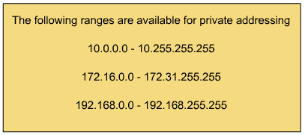
Private Addresses

Slide 62
Reserved Address Space
Network ID
Broadcast address
Hosts for classes of IP addresses

Slide 63
Basics of Subnetting
Classical IP addressing
Subnetworks
Subnet mask
Boolean operations: AND, OR, and NOT
Performing the AND function

Slide 64
Subnetworks
To create a subnet address, a network administrator borrows bits from the original host portion and designates them as the subnet field.

Slide 65
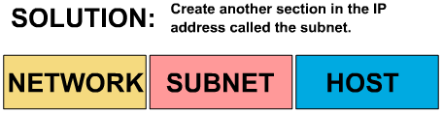
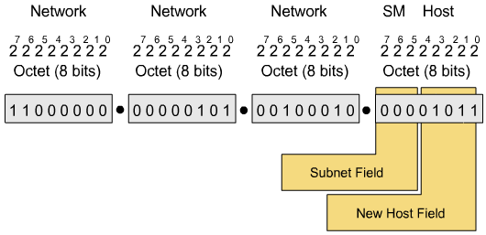
Subnetworks

Slide 66
Subnet Mask
Determines which part of an IP address is the network field and which part is the host field
Follow these steps to determine the subnet mask:
1. Express the subnetwork IP address in binary form.
2. Replace the network and subnet portion of the address with all 1s.
3. Replace the host portion of the address with all 0s.
4. Convert the binary expression back to dotted-decimal notation.

Slide 67
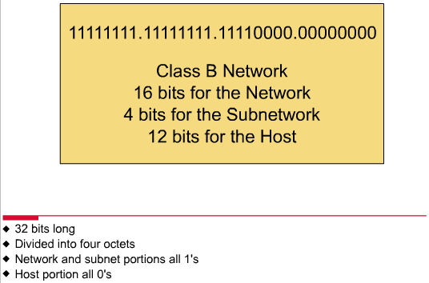
Subnet Mask
Subnet mask in decimal = 255.255.240.0

Slide 68
Boolean Operations: AND, OR, and NOT
AND is like multiplication.
OR is like addition.
NOT changes 1 to 0, and 0 to 1.

Slide 69
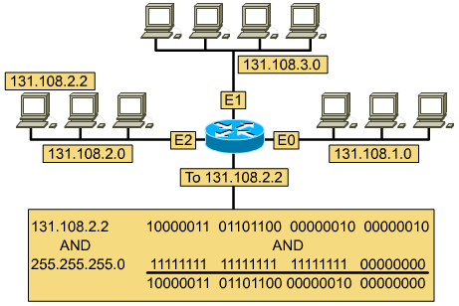
Performing the AND Function

Slide 70
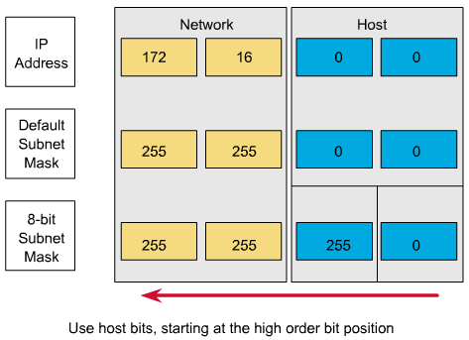
Range of Bits Needed to Create Subnets

Slide 71
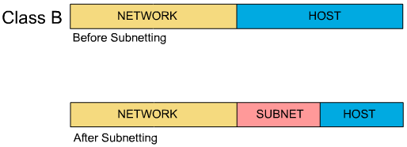
Subnet Addresses

Slide 72
Creating a Subnet
Determining subnet mask size
Computing subnet mask and IP address
Computing hosts per subnetwork
Boolean AND operation
IP configuration on a network diagram
Host and subnet schemes
Private addresses

Slide 73
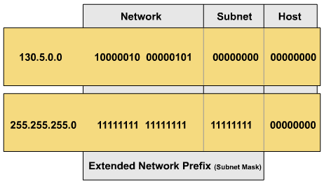
Determining Subnet Mask Size
Class B address with 8 bits borrowed for the subnet
130.5.2.144 (8 bits borrowed for subnetting) routes to subnet 130.5.2.0 rather than just to network 130.5.0.0.

Slide 74
Determining Subnet Mask Size
Class C address 197.15.22.131 with a subnet mask of 255.255.255.224 (3 bits borrowed)
11000101 | 00001111 | 00010110 | 100 | 00011
Network Field |  |  | SN | Host Field
The address 197.15.22.131 would be on the subnet 197.15.22.128.

Slide 75
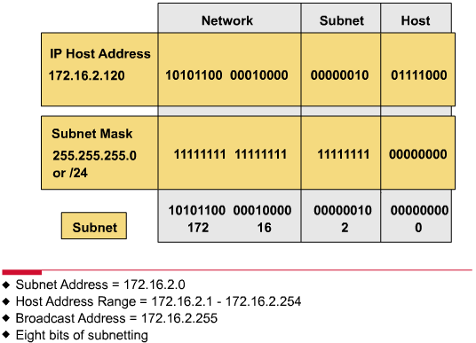
Subnetting Example with AND Operation

Slide 76
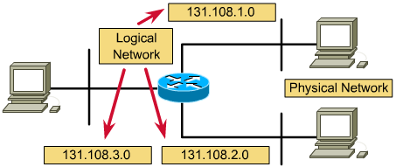
IP Configuration on a Network Diagram
The router connects subnetworks and networks.

Slide 77
Subnet Example
Given the Class B address 190.52.0.0
Class B
Network
Network
Host
Host
Using /24 subnet...
190.52.1.2
190.52.2.2
190.52.3.2
Network
Network
Subnet
Host
Internet routers still “see” this net as 190.52.0.0
But internal routers think all these addresses are on different networks, called subnetworks

Slide 78
Subnet Example
Network
Network
Subnet
Host
Using the 3rd octet, 190.52.0.0 was divided into:
190.52.1.0 190.52.2.0 190.52.3.0 190.52.4.0
190.52.5.0 190.52.6.0 190.52.7.0 190.52.8.0
190.52.9.0 190.52.10.0 190.52.11.0 190.52.12.0
190.52.13.0 190.52.14.0 190.52.15.0 190.52.16.0
190.52.17.0 190.52.18.0 190.52.19.0 and so on ...

Slide 79
Subnet Example
Network address 190.52.0.0 with /16 network mask
Using Subnets: subnet mask 255.255.255.0 or /24
Network
Network
Subnet
Host
190
52
0
Host
Subnets
190
52
1
Host
190
52
2
Host
255 Subnets
2⁸ - 1
190
52
3
Host
190
52
Etc.
Host
190
52
254
Host
Cannot use last subnet as it contains broadcast address
190
52
255
Host

Slide 80
Subnet Example
Subnet 0 (all 0’s subnet) issue: The address of the subnet, 190.52.0.0/24 is the same address as the major network, 190.52.0.0/16.
Network
Network
Subnet
Host
190
52
0
Host
Subnets
190
52
1
Host
190
52
Etc.
Host
255 Subnets
2⁸ - 1
190
52
254
Host
190
52
255
Host
Last subnet (all 1’s subnet) issue: The broadcast address for the subnet, 190.52.255.255 is the same as the broadcast address as the major network, 190.52.255.255.

Slide 81
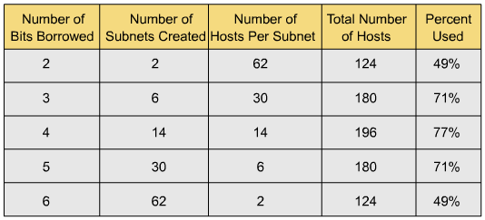
Host Subnet Schemes
The number of lost IP addresses with a Class C network depends on the number of bits borrowed for subnetting.

Slide 82
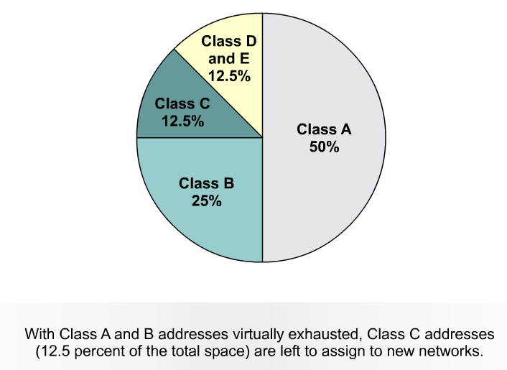
IP addressing crisis
Address Depletion
Internet Routing Table Explosion

Slide 83
IPv4 Addressing
Subnet Mask
One solution to the IP address shortage was thought to be the subnet mask.
Formalized in 1985 (RFC 950), the subnet mask breaks a single class A, B or C network in to smaller pieces.

Slide 84
Short Term Solutions: IPv4 Enhancements
CIDR (Classless Inter-Domain Routing) – RFCs 1517, 1518, 1519, 1520
VLSM (Variable Length Subnet Mask) – RFC 1009
Private Addressing - RFC 1918
NAT/PAT (Network Address Translation / Port Address Translation) – RFC

Slide 85
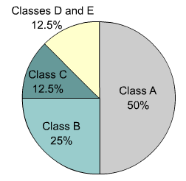
IPv4 versus IPv6
IP version 6 (IPv6) has been defined and developed.
IPv6 uses 128 bits rather than the 32 bits currently used in IPv4.
IPv6 uses hexadecimal numbers to represent the 128 bits.
IPv4

Slide 86
Long Term Solution: IPv6 (coming)
IPv6, or IPng (IP – the Next Generation) uses a 128-bit address space, yielding
340,282,366,920,938,463,463,374,607,431,768,211,456
possible addresses.
IPv6 has been slow to arrive
IPv4 revitalized by new features, making IPv6 a luxury, and not a desperately needed fix
IPv6 requires new software; IT staffs must be retrained
IPv6 will most likely coexist with IPv4 for years to come.
Some experts believe IPv4 will remain for more than 10 years.

Slide 87
Module 14-2 VLSM

Slide 89
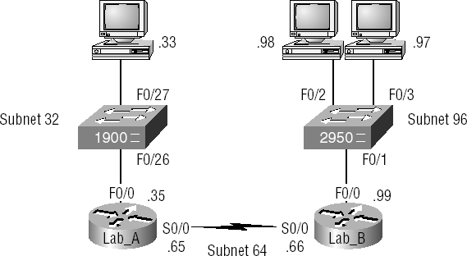
Variable Length Subnet Masks (VLSM)

Slide 90
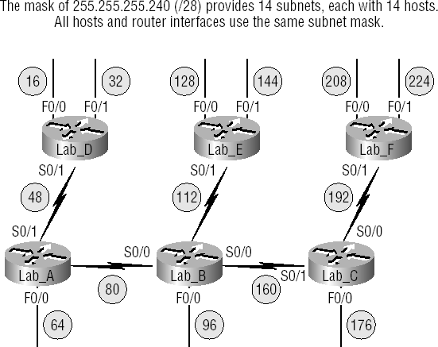
Subnets with no VLSM applied

Slide 91
Subnets with VLSM applied

Slide 92
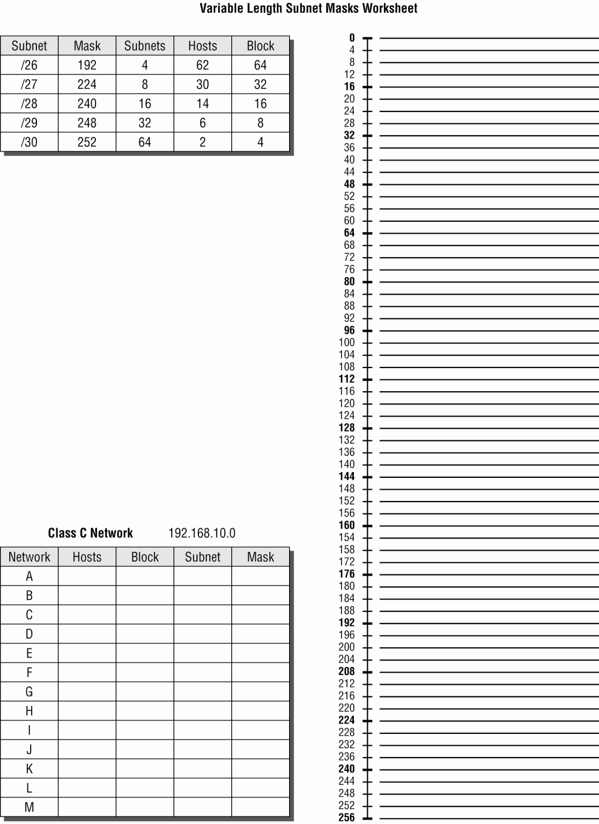

Slide 93
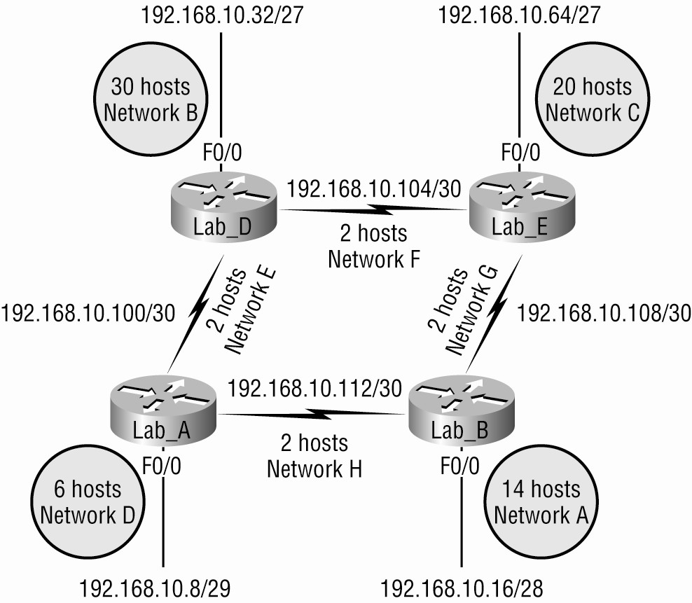
VSLM, Example 1

Slide 94
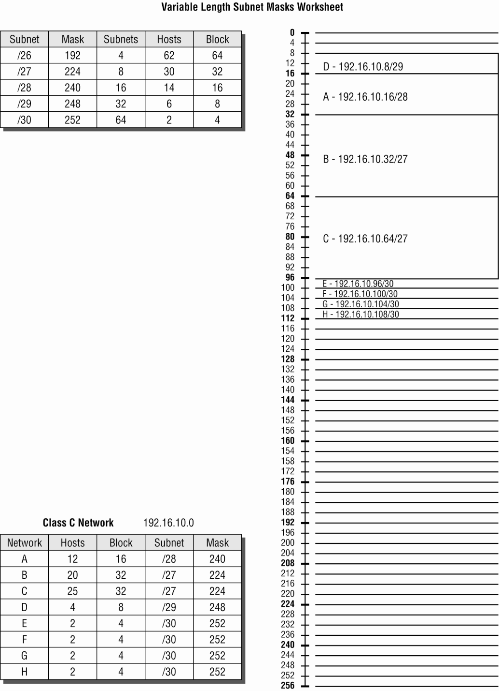

Slide 95
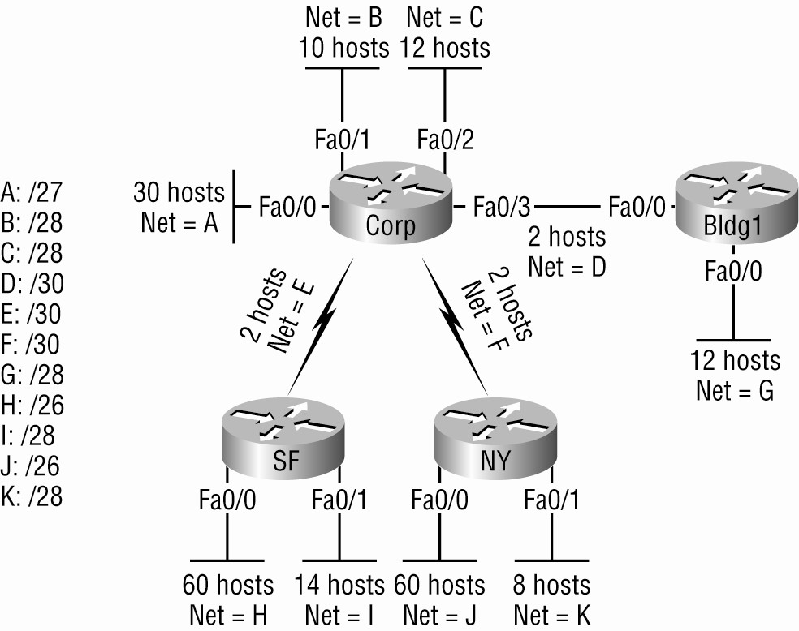
VLSM, Example 2

Slide 96
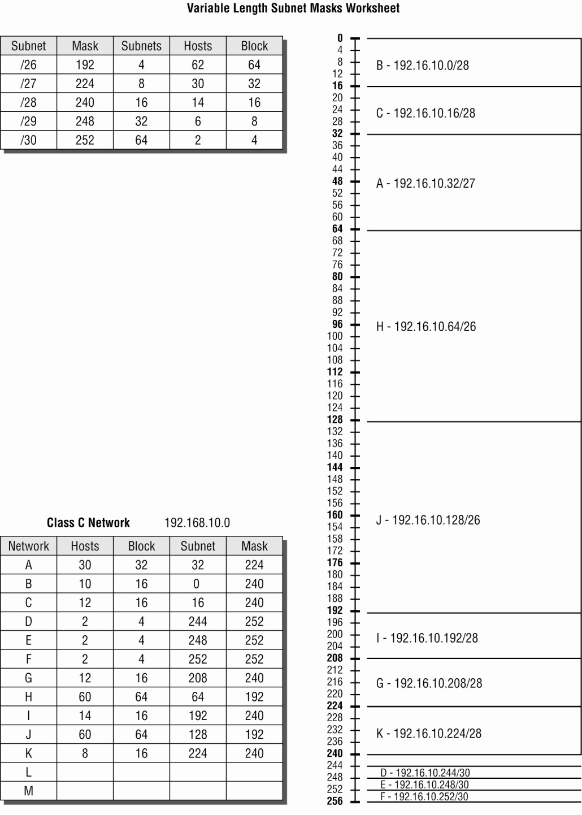

Slide 97
https://github.com/siagianp
https://www.youtube.com/@AmelOline/videos
https://github.com/amelcharolinesgn2/IoT_simulator-mqtt-NodeRed
https://github.com/amelcharolinesgn2/Cloud-Infrastructures
https://github.com/amelcharolinesgn2/ClouD-Infrastructure-SISKA-2025
https://github.com/amelcharolinesgn2/Gyroscope-Sensor-Data-Accelerometer
https://github.com/amelcharolinesgn2/Anjar_T
https://github.com/amelcharolinesgn2/Anjar_Lab
https://github.com/amelcharolinesgn2/ANJAR
https://drive.google.com/drive/folders/1YLs2wBBL3gWKKkh2g9nfVtOajQ7x6Mud

